Slide 1

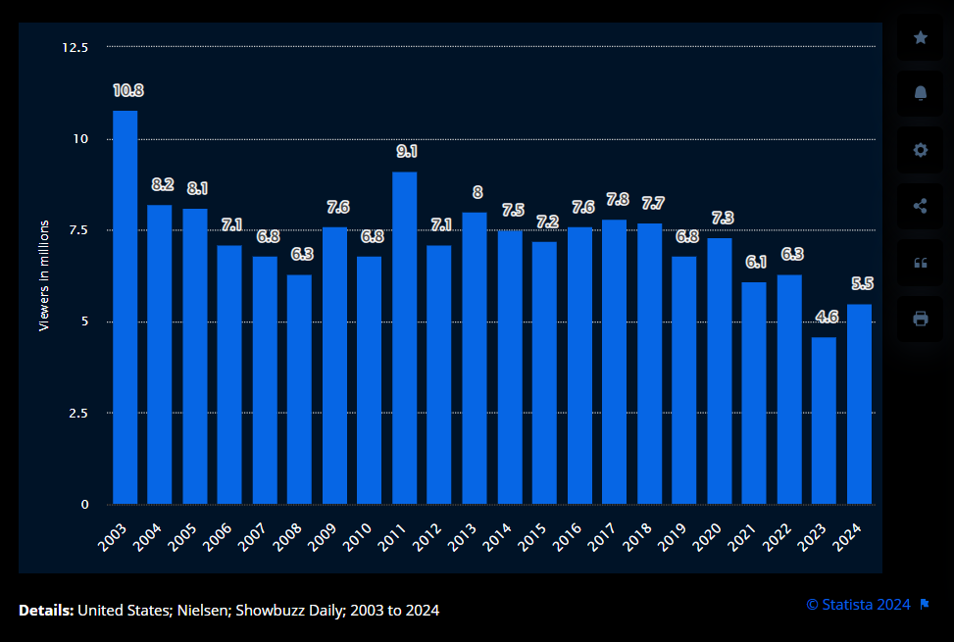

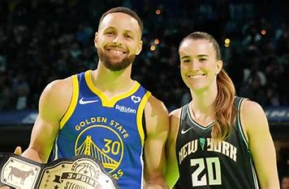
Average Number of Viewers of the All-Star Game
Average: 7.2
NBA All-Star 2024 had a 20% increase in viewership YoY.
All-Star Saturday Night viewership peaked peaked at 5.4 viewers during Stephen Curry and Sabrina Ionescu event (10 – 10.15 pm EST). 10 million unique viewers watched the shootout! (nba.com/news/all-star-saturday-night-ratings)
Most watched All-Star Saturday Night in the last 4 years.
2024 All-Star game featured Stephen Curry and Kevin Durant who did not participate in 2023 due to injuries.
The All-Star game returned to the East vs West format.

